Slide 1



Consumer Goods Ad-hoc Insight
By Surya Prakash Soni

Slide 2



Agenda
Overview of Company
Objective
About Data
Ad-hoc request with insights

Slide 3
Overview of Company
AtliQ Hardwares (imaginary company) is a leading India-based computer hardware manufacturer with a strong global presence.
The company operates across three divisions—Peripherals & Accessories, PCs, and Networking & Storage—offering a wide range of consumer and enterprise products.
AtliQ sells through retail, direct, and distributor channels, and its products are available across brick-and-mortar stores and e-commerce platforms in multiple countries.

Slide 4
Objective
AtliQ Hardwares wants to improve its ability to make quick, data-based decisions. To do this, the company plans to expand its data analytics team by hiring junior analysts. Tony Sharma designed a SQL challenge to test candidates’ technical skills and their ability to think and communicate clearly.

Slide 5
About Data
The dataset consists of 4 fact tables—sales monthly, manufacturing cost, pre-invoice deductions, and gross price—and 2 dimension tables containing customer and product details. Together, they provide a structured view of measurable business metrics and supporting information for analysis.
AtliQ Hardwares’ fiscal year starts from 1st September to 31st August.
Sales data is available for the fiscal year 2020–2021.

Slide 6
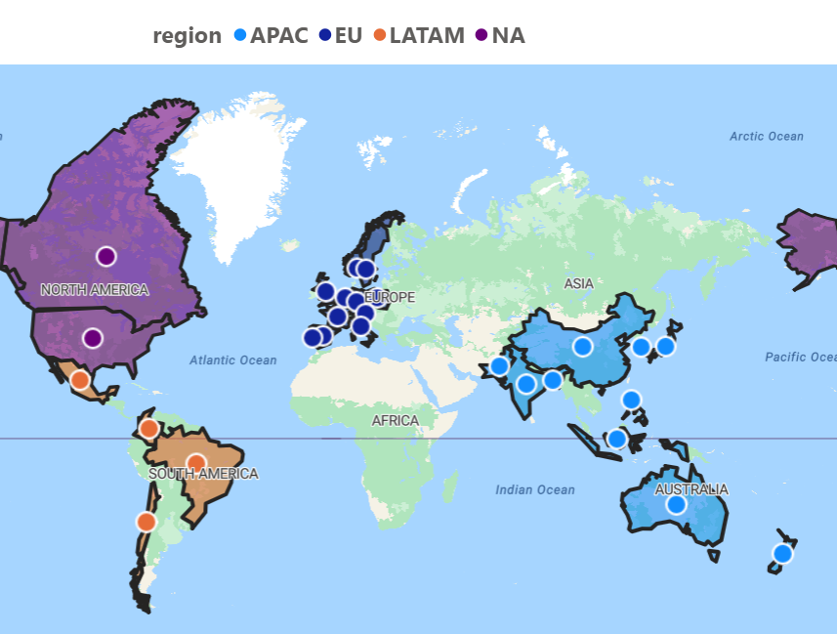
Company’s Market
AtliQ Hardwares operates in 27 countries across North America, Europe, and the APAC region.

Slide 7
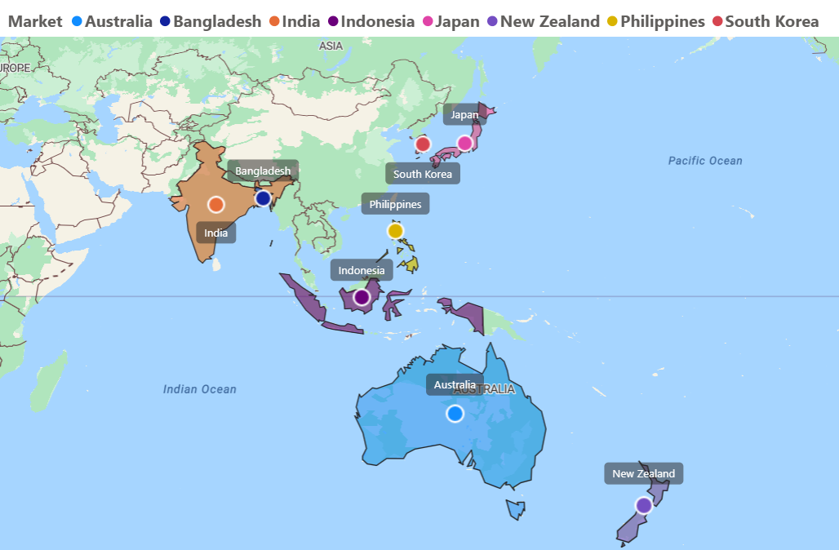
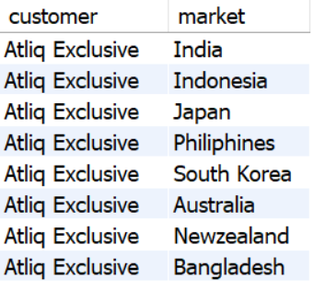
1.Provide the list of markets in which customer "Atliq Exclusive" operates its business in the APAC region.
Query :
select distinct customer, market from dim_customer where region = "APAC" and customer = "Atliq Exclusive" ;
INSIGHT
AtliQ Exclusive operates in 8 key APAC markets — covering South Asia, Southeast Asia, and Oceania. This wide presence shows strong regional diversification and business reach.

Slide 8
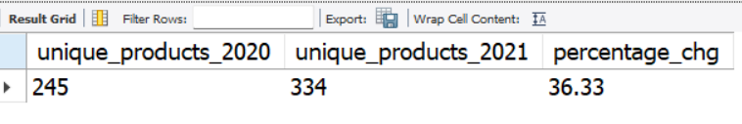
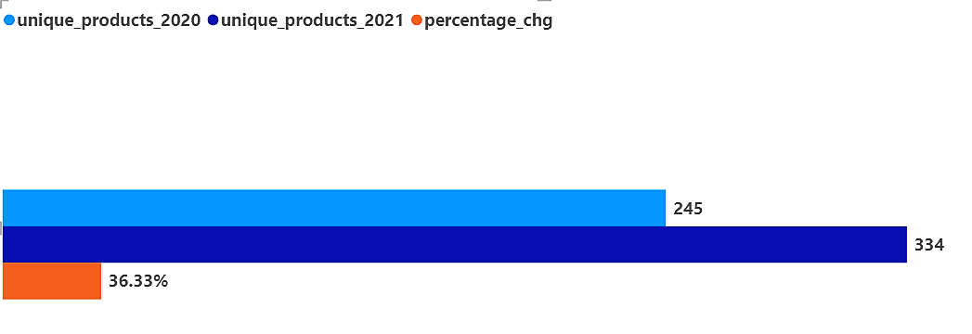
2. What is the percentage of unique product increase in 2021 vs. 2020? The final output contains these fields, unique_products_2020, unique_products_2021,percentage_chg .
Query :
with cte1 as
(SELECT COUNT(DISTINCT product_code) AS unique_products_2020 FROM fact_sales_monthlyWHERE fiscal_year = 2020),
cte2 as
(SELECT COUNT(DISTINCT product_code) AS unique_products_2021 FROM fact_sales_monthlyWHERE fiscal_year = 2021)
select unique_products_2020, unique_products_2021, round((unique_products_2021/unique_products_2020 -1)*100,2) as percentage_chgfrom cte1 join cte2;
Unique product comparison for FY 2020 and FY 2021
INSIGHT
Unique products increased from 245 in 2020 to 334 in 2021 — a growth of 36.33%. This shows strong expansion in the product portfolio.

Slide 9
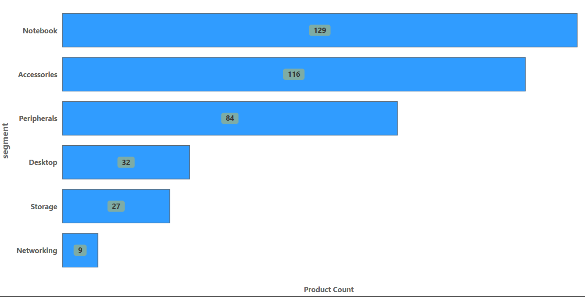
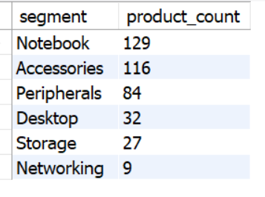
3.Provide a report with all the unique product counts for each segment and sort them in descending order of product counts. The final output contains 2 fields, segment, product_count.
Query :
Select segment, count(distinct product_code) as product_count from dim_product group by segment order by product_count desc;
INSIGHT
Notebook and Accessories have the highest product variety, showing strong demand and customer interest.
Networking and Storage have very few products, indicating low presence and untapped market potential.

Slide 10
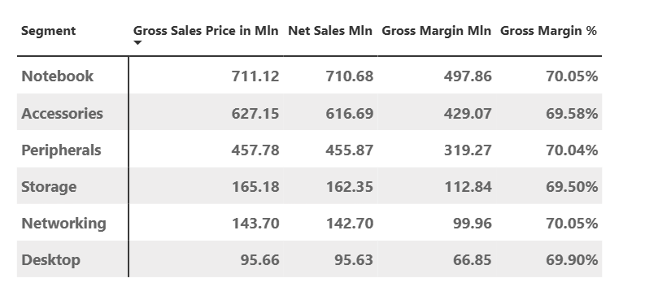
Sales and Margin Performance by Segment
INSIGHT
Notebook has the highest sales, contributing the most revenue.
Accessories and Peripherals also generate strong sales, forming the mid-tier performers.
Margins are stable across all segments (~70%), meaning profit quality is consistent.
Desktop, Storage, and Networking have the lowest sales, showing under-performance.

Slide 11
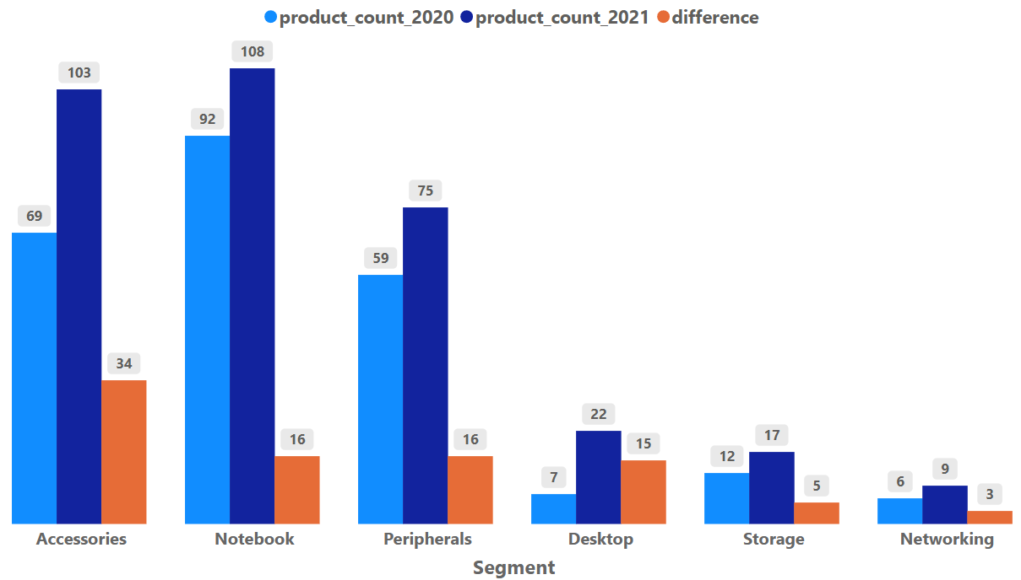
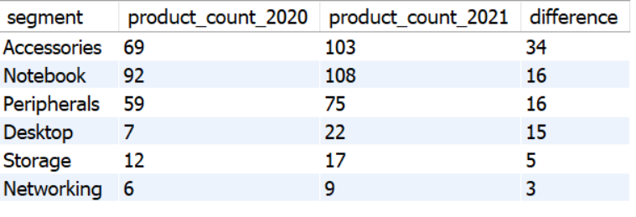
4. Follow-up: Which segment had the most increase in unique products in 2021 vs 2020? The final output contains these fields, segment, product_count_2020, product_count_2021, difference.
Query :
with cte1 as (
Select segment, count(distinct product_code) as product_count_2020 from dim_product join fact_sales_monthly using (product_code) where fiscal_year = 2020 group by segment
),
cte2 as (
Select segment, count(distinct product_code) as product_count_2021 from dim_product join fact_sales_monthly using (product_code) where fiscal_year = 2021 group by segment
)
Select c1.segment, product_count_2020, product_count_2021, (product_count_2021 - product_count_2020) as difference from cte1 c1 join cte2 c2 on c1.segment = c2.segment order by difference desc;
INSIGHT
Accessories had the biggest increase in unique products (+34).
Notebook and Peripherals also grew moderately (+16 each).
Desktop, Storage, and Networking had small increases, indicating limited product expansion.
Accessories is becoming a fast-growing segment with strong product development.

Slide 12
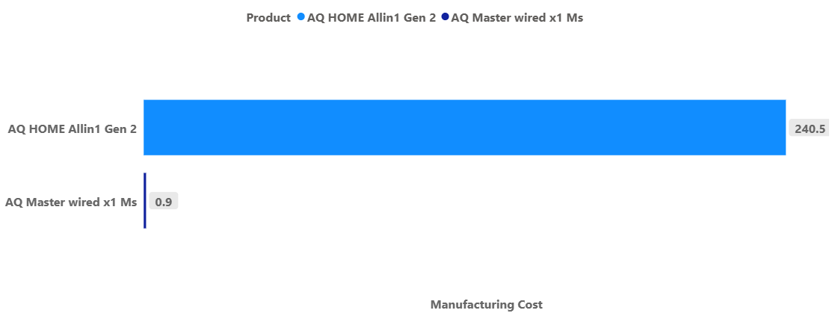


5. Get the products that have the highest and lowest manufacturing costs. The final output should contain these fields, product_code, product, manufacturing_cost.
Query :
Select c.product_code, p.product, c.manufacturing_cost from fact_manufacturing_cost c
join dim_product p using(product_code)
where c.manufacturing_cost = (select min(manufacturing_cost) from fact_manufacturing_cost) or c.manufacturing_cost = (select max(manufacturing_cost) from fact_manufacturing_cost) ;
INSIGHT
AQ Master Wired x1 Ms has the lowest manufacturing cost (0.89) → high profit potential.
AQ HOME AllIn1 Gen 2 has the highest manufacturing cost (240.53) → requires premium pricing or value-added strategy.

Slide 13
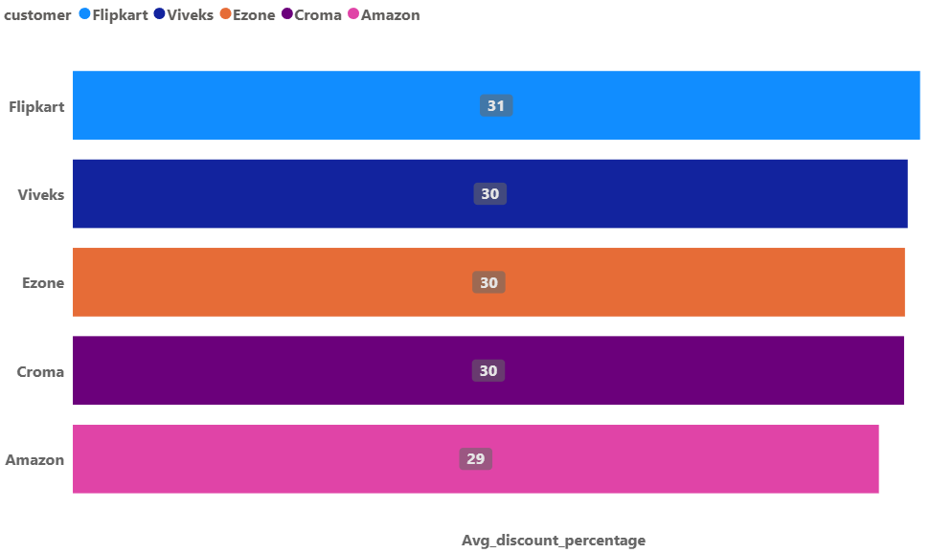
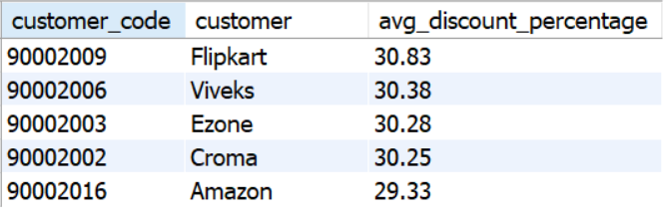
6. Generate a report which contains the top 5 customers who received an average high pre_invoice_discount_pct for the fiscal year 2021 and in the Indian market. The final output contains these fields, customer_code, customer, average_discount_percentage.
Query :
select pre.customer_code, c.customer, round(avg(pre.pre_invoice_discount_pct*100),2) as avg_discount_percentage from fact_pre_invoice_deductions pre
join dim_customer c on pre.customer_code = c.customer_code where c.market = 'India’ and fiscal_year = 2021 group by pre.customer_code, c.customer order by avg_discount_percentage desc limit 5 ;
INSIGHT
Flipkart received the highest average discount (30.83%) among Indian customers in FY 2021.
Viveks, Ezone, and Croma also received similarly high discounts (~30%).
Amazon received the lowest among the top five (29.33%), but still high.
High discounts indicate these customers are valuable, high-volume buyers.

Slide 14
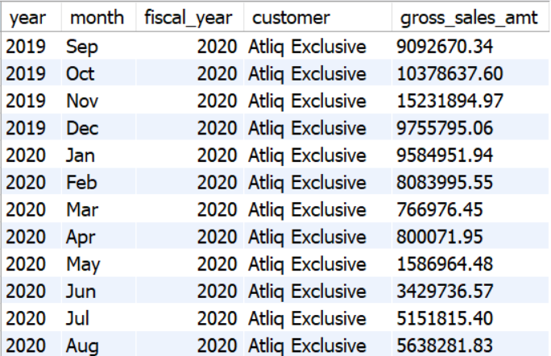
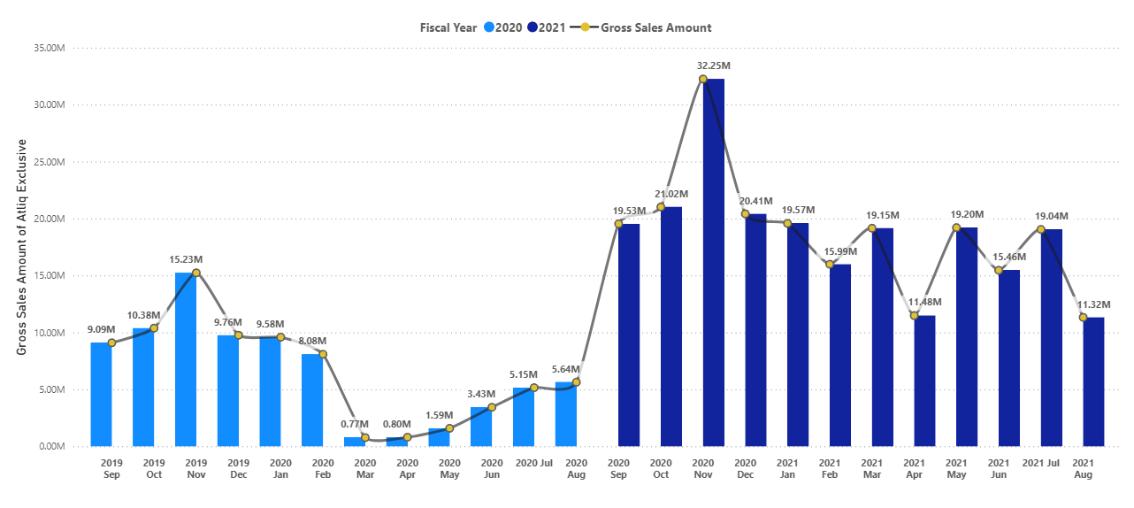
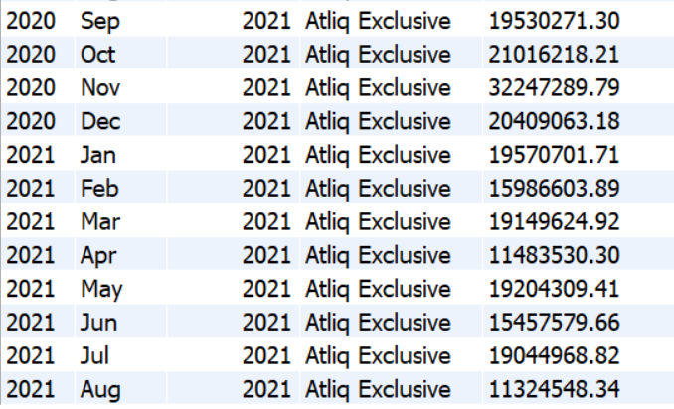
7. Get the complete report of the Gross sales amount for the customer “Atliq Exclusive” for each month . This analysis helps to get an idea of low and high-performing months and take strategic decisions. The final report contains these columns: Month, Year, Gross sales Amount.
Query :
Select year(s.date) as year, date_format(s.date,'%b’) as month, s.fiscal_year, c.customer, round(sum(gross_price * sold_quantity),2) as gross_sales_amt from fact_sales_monthly s join dim_customer c on s.customer_code = c.customer_code join fact_gross_price gp on s.product_code = gp.product_code where c.customer = 'Atliq Exclusive’ group by year, month order by s.fiscal_year ;

Slide 15
INSIGHT
2020 shows a strong recovery after a big drop in Feb–Apr (pandemic impact).
Peak sales months: 1. Nov 2020 – 32.25M (highest overall)
2. Oct 2020 & Dec 2020 also strong.
2021 is more stable, with consistent monthly sales between 15M–21M.
Low-performing periods were early 2020 (Mar–Apr) and mid 2021 (Aug).
AtliQ Exclusive depends heavily on festive/winter months for high revenue.

Slide 16
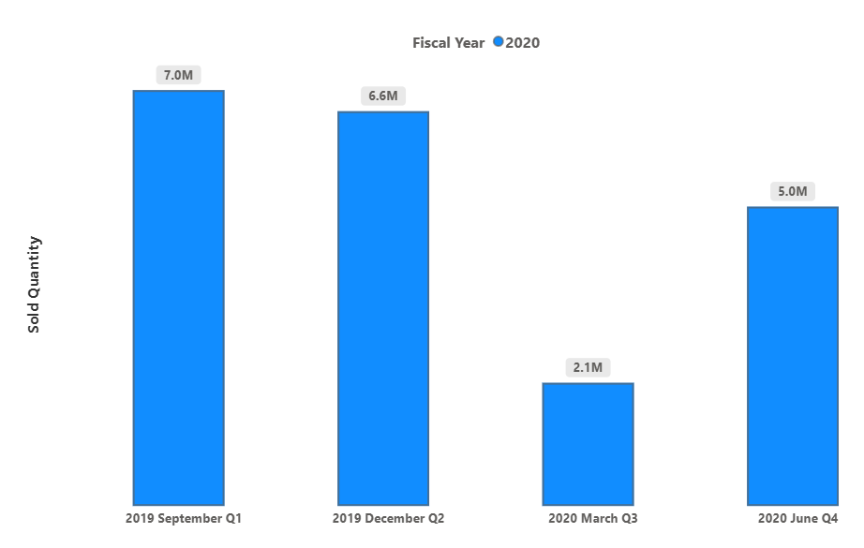
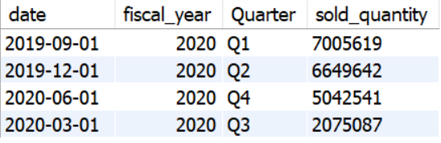
8. In which quarter of 2020, got the maximum total_sold_quantity? The final output contains these fields sorted by the total_sold_quantity, Quarter, total_sold_quantity.
Query :
with cte1 as (
select date, fiscal_year,
case
when month(date) in (9,10,11) then "Q1" when month(date) In (12,01,02) then "Q2" when month(date) in (03,04,05) then "Q3" else "Q4“
end as Quarter,
sum(sold_quantity) as sold_quantity from fact_sales_monthly group by fiscal_year, Quarter order by fiscal_year, Quarter
)
Select * from cte1 where fiscal_year = 2020 order by sold_quantity desc;
INSIGHT
Q1 2020 had the highest sold quantity (7.0M units) — strongest quarter.
Q2 2020 was also strong (6.6M units) — good festive/winter season continuation.
Q4 2020 performed moderately (5.0M units).
Q3 2020 had the lowest sold quantity (2.1M units) — major drop likely due to early 2020 disruptions.

Slide 17
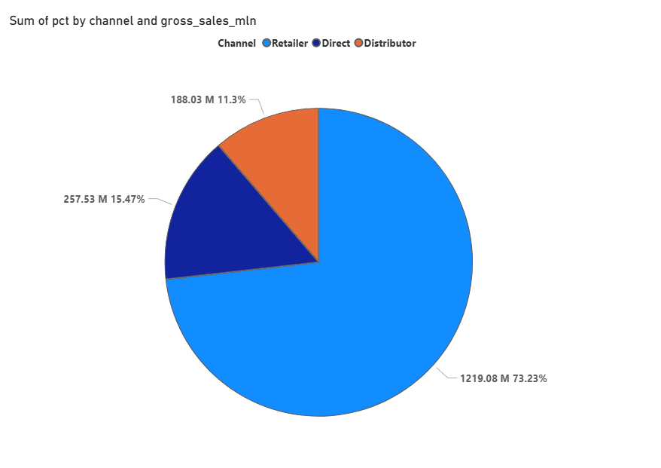
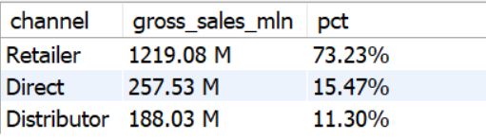
9. Which channel helped to bring more gross sales in the fiscal year 2021 and the percentage of contribution? The final output contains these fields, channel, gross_sales_mln ,percentage.
Query :
Select c.channel, concat(round(sum(s.sold_quantity * gp.gross_price)/1000000,2), ' M’) as gross_sales_mln, concat(round(sum(s.sold_quantity * gp.gross_price)*100 / sum(sum(s.sold_quantity * gp.gross_price)) over (),2),'%') as pct
from fact_sales_monthly s
join fact_gross_price gp on gp.product_code = s.product_code and gp.fiscal_year = s.fiscal_year join dim_customer c on c.customer_code = s.customer_code where s.fiscal_year = 2021 group by s.fiscal_year, channel order by s.fiscal_year , pct desc;
INSIGHT
Retailer channel is the biggest contributor, generating 73.23% of total sales (~1219M).
Direct channel contributes 15.47%, showing moderate performance.
Distributor channel is the lowest contributor with 11.30%, indicating low reach or weak partnerships.
Retailers are the core revenue driver for the business.

Slide 18
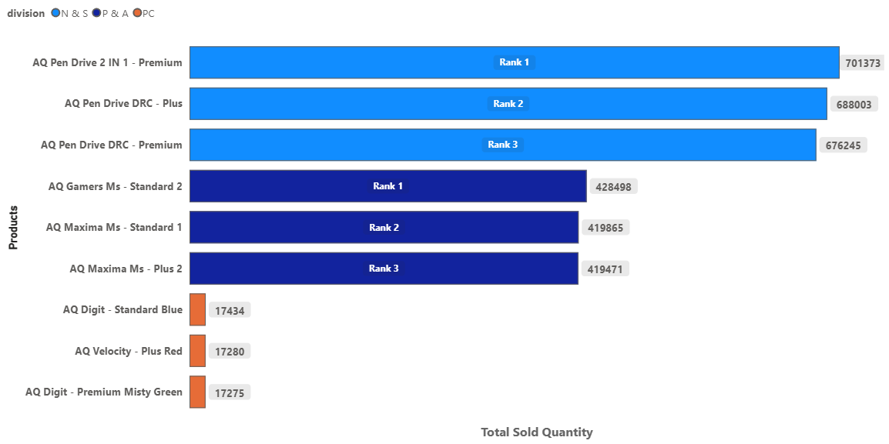
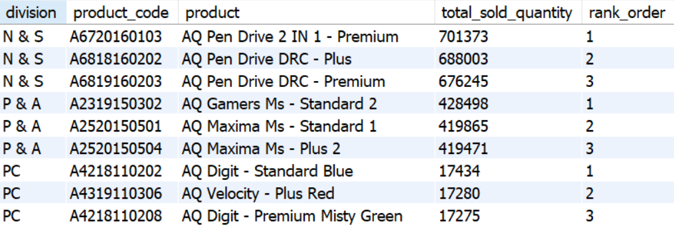
10. Get the Top 3 products in each division that have a high total_sold_quantity in the fiscal_year 2021? The final output contains these fields, division, product_code, product, total_sold_quantity , rank_order.
Query :
with cte1 as (
select p.division, p.product_code, concat(p.product , ' - ', p.variant) as product, sum(s.sold_quantity) as total_sold_quantity from dim_product p
Join fact_sales_monthly s on p.product_code = s.product_code where fiscal_year = 2021 group by product_code , division
),
cte2 as (
Select *, rank() over(partition by division order by total_sold_quantity desc) as rank_order from cte1
)
Select * from cte2 where rank_order <= 3 ;
INSIGHT
N & S Division
Pen drives dominate with exceptionally high sales. Top sellers: 701K, 688K, and 676K units.
2. P & A Division
Strong performance from Gaming and Maxima series, each selling around 419K–428K units.
3. PC Division
Sales are significantly lower, with top products only around 17K units—far behind other divisions.

Slide 19
SUGGESTIONS
1. Boost Top-Selling Segments (Notebook & Accessories)
Run bundle offers (Notebook + Accessories)
Promote with seasonal discounts, student offers, and influencer campaigns
Highlight best-selling models in ads.
2. Grow Low-Product Segments (Networking & Storage)Run bundle offers (Notebook + Accessories)
Partner with retailers/e-commerce for visibility.
Create awareness campaigns showing why customers need better networking/storage solutions.
3. Increase Cross-Selling
When customers buy notebooks, recommend peripherals (mouse, keyboard, webcam)
For businesses, offer bulk deals (Desktop + Storage + Networking).
4. Targeted Marketing in APAC
Promote budget products in India, Indonesia, Philippines.
Push premium products in Japan, Australia, New Zealand.
5. Accessories grew fastest—promote it with bundles, warranty, and service offers while using strong service benefits (on-site support, installation, extended warranty) to boost slow-growth segments like Desktop, Storage, and Networking.

Slide 20
SUGGESTIONS
Boost Festive & High-Month Sales
Run special festive campaigns in Sep–Dec.
Offer bundle deals, limited-time discounts, and cashback during peak demand.
Launch new product models around Oct–Nov.
2. Improve Low-Month Performance (Mar–Apr, Jul–Aug)
Provide seasonal offers, “back-to-work” and “back-to-school” deals.
Push accessories & peripherals with combo promotions.
Offer free servicing or extended warranty to attract purchases in slow months.
3. Retain Customer Loyalty Through Service
Add free on-site installation for high-value orders.
Offer subscription-based service plans like extended warranty or accidental damage cover.
4. Targeted Product Strategy
Sell high-value products during peak months (Nov–Dec).
Push entry-level and mid-range products during slow months.
Clear old inventory via season-end sales in Feb–Mar & Jul–Aug.
5. Strengthen Relationships With High-Discount Customers
Provide exclusive pricing agreements for Flipkart, Viveks, Ezone, Croma.
Introduce performance-based discounting (higher sales → better discount)
6. Improve Amazon’s Engagement
Offer targeted promotions to increase order volumes.
Provide co-marketing support (shared ads, product launches).
7. Use Discounts to Drive Product-Specific Growth
Promote slow-selling products through these retailers with special campaign discounts.
Run joint festival promotions with Flipkart & Amazon (Diwali, Big Billion Days).

Slide 21

Thanks!

